Slide 1
Growing In Stature
From small beginnings
Adrian Liew
27/11/2016

Slide 2
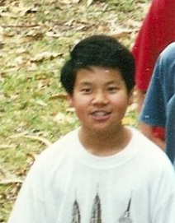
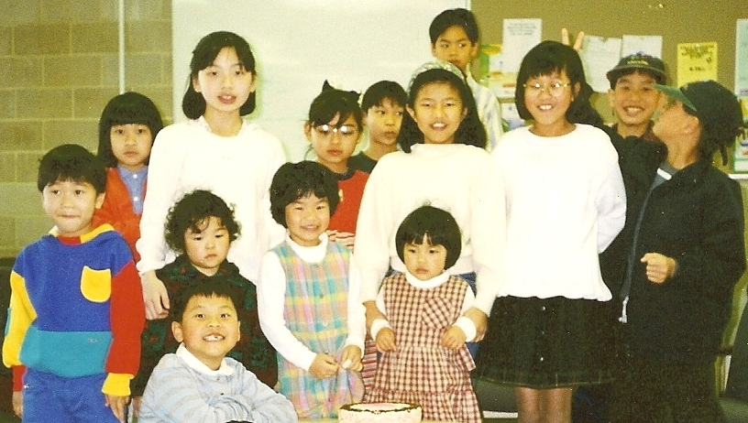
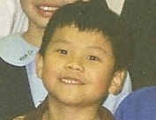
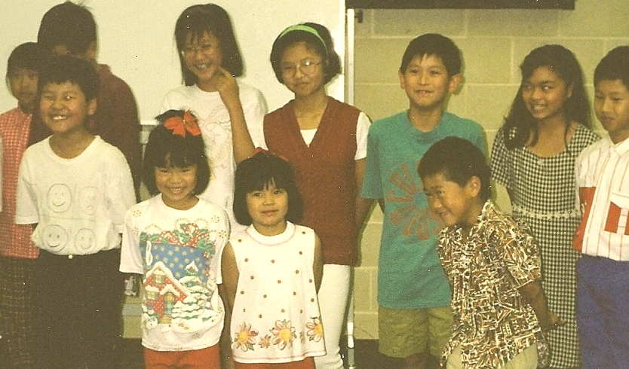
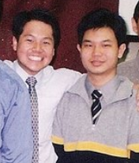
Adrian Growing Up at Evangel

Slide 3
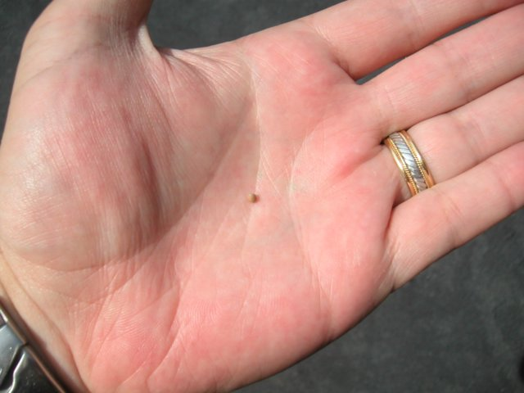
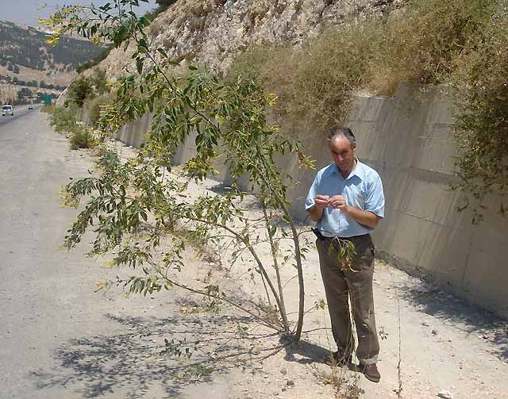
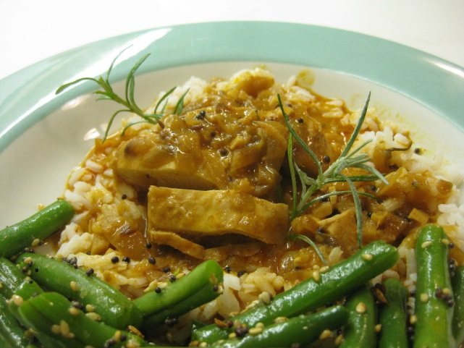
The Mustard Seed – Small Beginnings
Zechariah 4:8-10 (NLT)
Then another message came to me from
the Lord: “Zerubbabel is the one who laid the foundation of this Temple, and he will complete it. Then you will know that the
Lord of Heaven’s Armies has sent me. Do not despise these small beginnings, for
the Lord rejoices to see the work begin…
Mustard Seed: Small beginnings

Slide 4
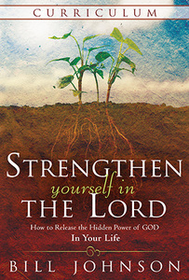
Strengthen Yourself in the Lord
Devotional: Day One
“God did not bring the man (David) after His heart straight from the pasture to the palace. Incredibly, David did not assume the throne until 10 to 13 years after Samuel had anointed him to be king”

Slide 5
Strengthen Yourself in the Lord
“So David, even though he already possessed a heart for the Lord, was led into years of testing that groomed him to handle the glory and responsibility of the throne”

Slide 6
Strengthen Yourself in the Lord
“The scriptural account of this in David’s life is filled with lessons on the kinds of Character tests we all face on the road to fulfilling our destiny in God”

Slide 7
Strengthen Yourself in the Lord
“David’s response to Lord in private would ultimately position him for public promotion”

Slide 8
CHARACTER COUNTS!
Our character determines how much we will grow in stature

Slide 9
Back to the Mustard Seed…
He gave them another parable [to consider], saying, “The kingdom of heaven is like a mustard seed, which a man took and sowed in his field; and of all the seeds [planted in the region] it is the smallest, but when it has grown it is the largest of the garden herbs and becomes a tree, so that THE BIRDS OF THE AIR FIND SHELTER IN ITS BRANCHES.” Matthew 13:31:32 (AMP)

Slide 10
Back to the Mustard Seed…
And He said, “How shall we picture the kingdom of God, or what parable shall we use to illustrate and explain it? It is like a mustard seed, which, when it is sown on the ground, even though it is smaller than all the [other] seeds that are [sown] on the soil, yet when it is sown, it grows up and becomes larger than all the garden herbs; and it puts out large branches, so that THE BIRDS OF THE SKY are able to MAKE NESTS and LIVE UNDER ITS SHADE.” Mark 4:30-32 (AMP)

Slide 11
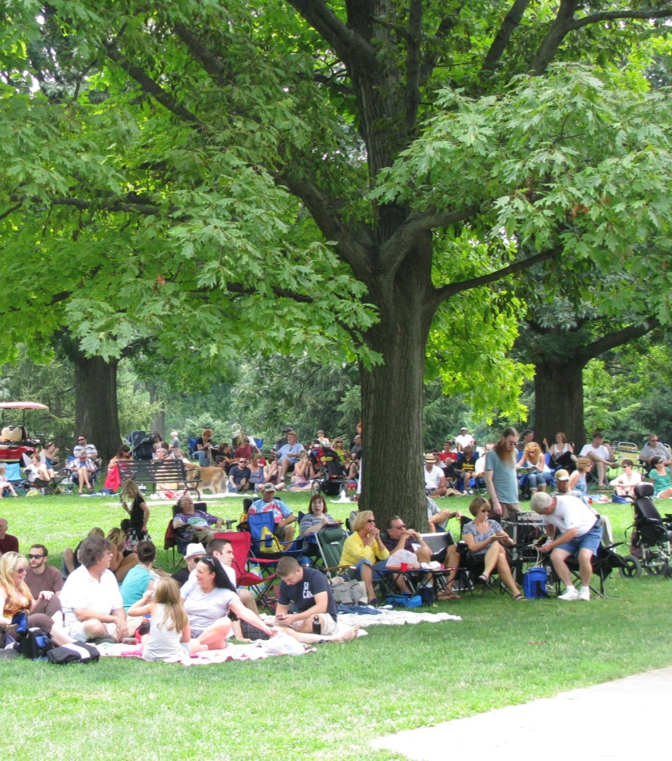
Back to the Mustard Seed…
You can start out as the smallest or the least, but God can cause you to grow into greater maturity and influence.
God can supernaturally accelerate your growth
Your life draws people from afar to camp under your influence

Slide 12
Back to the Mustard Seed…
So this led Him to say, “What is the kingdom of God like? And to what shall I compare it? It is like a mustard seed, which a man took and planted in his own garden; and it grew and became a tree, and THE BIRDS OF THE SKY FOUND SHELTER and NESTED IN ITS BRANCHES.” Luke 13:18-22 (AMP)

Slide 13
Back to the Mustard Seed…
It’s not a competition, it’s about The Kingdom of God
Your life becomes a shelter for those under you

Slide 14
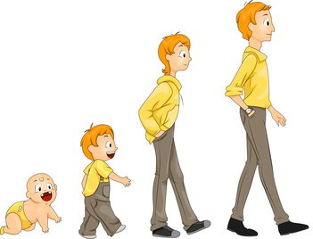
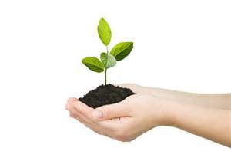
Growth = How We Respond
How are we responding to God’s dealings and corrections?
How are responding through the seasons God is bringing us through?
Is this all done in faith?

Slide 15
27th November 2011 Midnight
There is no limit to how much God can use a person or a group of people who can receive support, correction, praise and persecution with the same gracious spirit.

Slide 16
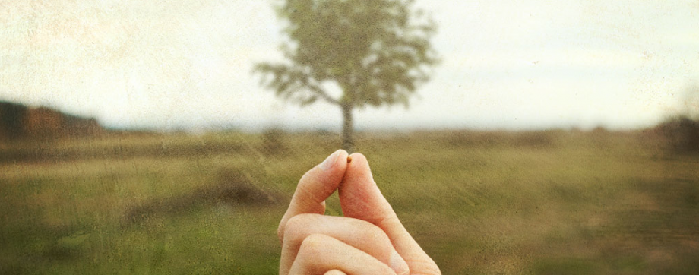
Growing In Stature
Conclusion
Embrace the small beginnings!
Character Counts!
Don’t discount where you’re at right now
Your life is making an impact for Christ!

